Slide 1


LINDEN PUBLIC SCHOOLS
STRATEGIC PLANNING
MEETING
STATE OF THE DISTRICT
Atiya Y. Perkins
Superintendent of Schools

Slide 2
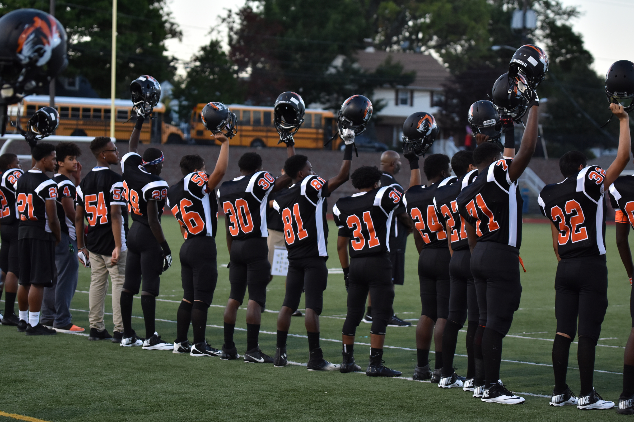

VISION:
The Linden Public School District is committed to developing respect for diversity, excellence in education, and a commitment to service, in order to promote global citizenship and ensure personal success for all students.
MISSION:
The mission of the Linden Public Schools District is to promote distinction through the infinite resource that is Linden’s diversity, combined with our profound commitment to instructional excellence, so that each and every student achieves their maximum potential in an engaging, inspiring, and challenging learning environment.

Slide 3

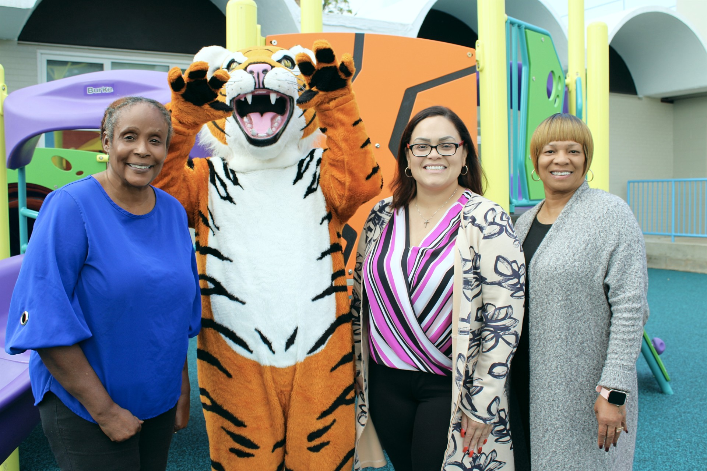
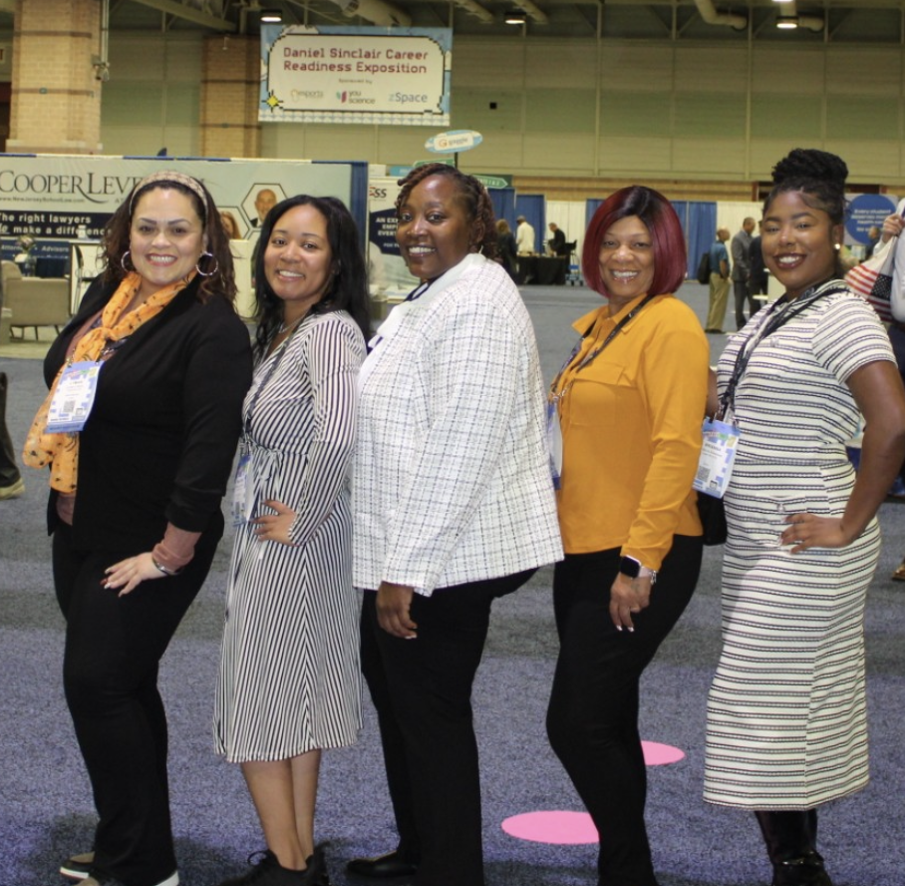
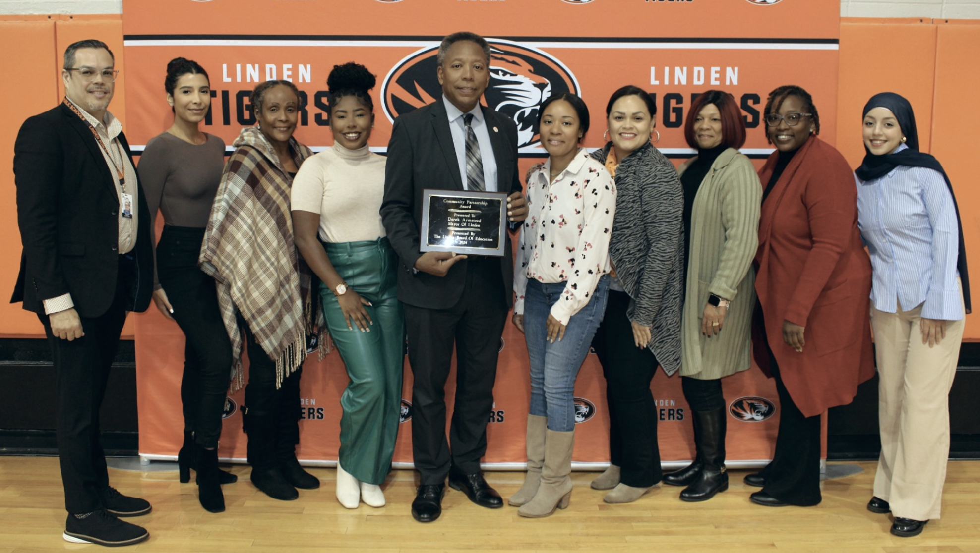
BOARD OF EDUCATION
Who serves on the Board of Education?
Nine unpaid volunteers from the Linden community reside at Linden residence and serve on the board of education for three-year terms. Registered voters elect these members during the November General election. Monthly meetings occur where they gather to discuss and adopt policies and conduct board business. Meeting dates, times, locations, and meeting agendas are found on the district website. Members of the public are encouraged to attend and can speak during the public portion of the meetings.
What Drives the Board’s Decision-Making Processes?
All district policies can be found on the Linden Public Schools website to ensure consistent and fair decision-making by the board and the district personnel. The board’s focus includes:
Student success: Ensures all students have a path to academic excellence.
Community input: Consider input from the community, including families, teachers, students, and the public. They also engage with local organizations to gather input and foster collaboration.
Budget and finance: Manage the district's budget, including how money is spent on teacher salaries, technology, and extracurricular programs.
School policies: Establish policies that affect the day-to-day lives of the school community
Equity issues: Consider equity issues for various student populations, including historically underserved students, immigrant students, and English Language Learners.

Slide 4
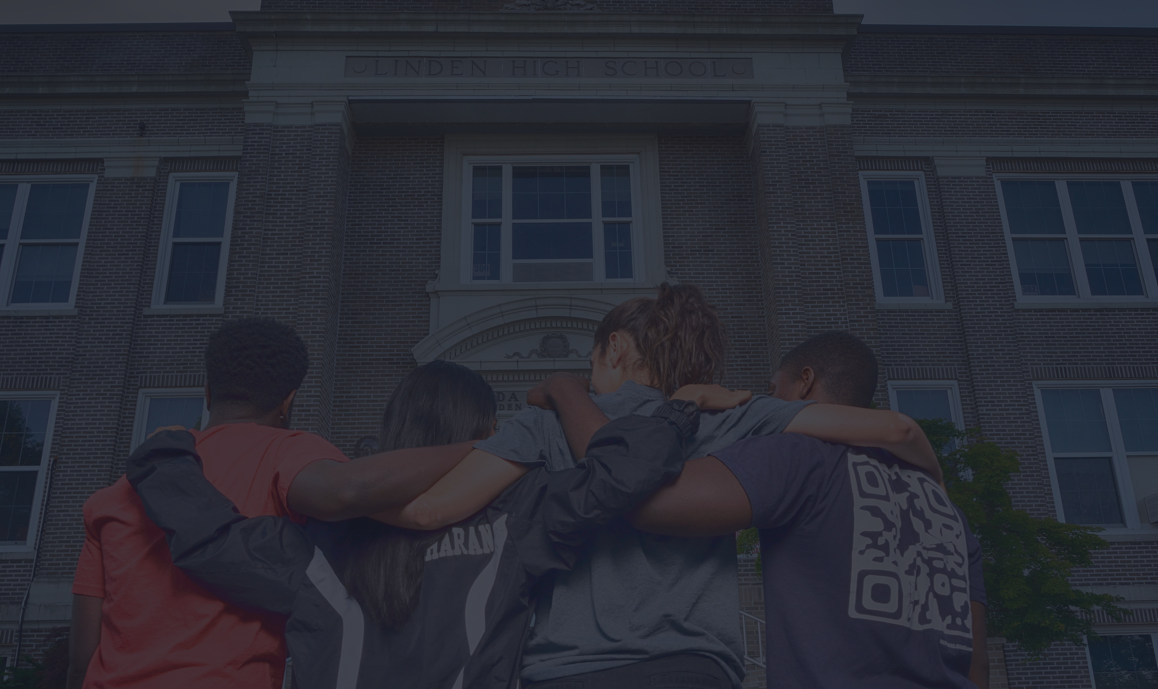
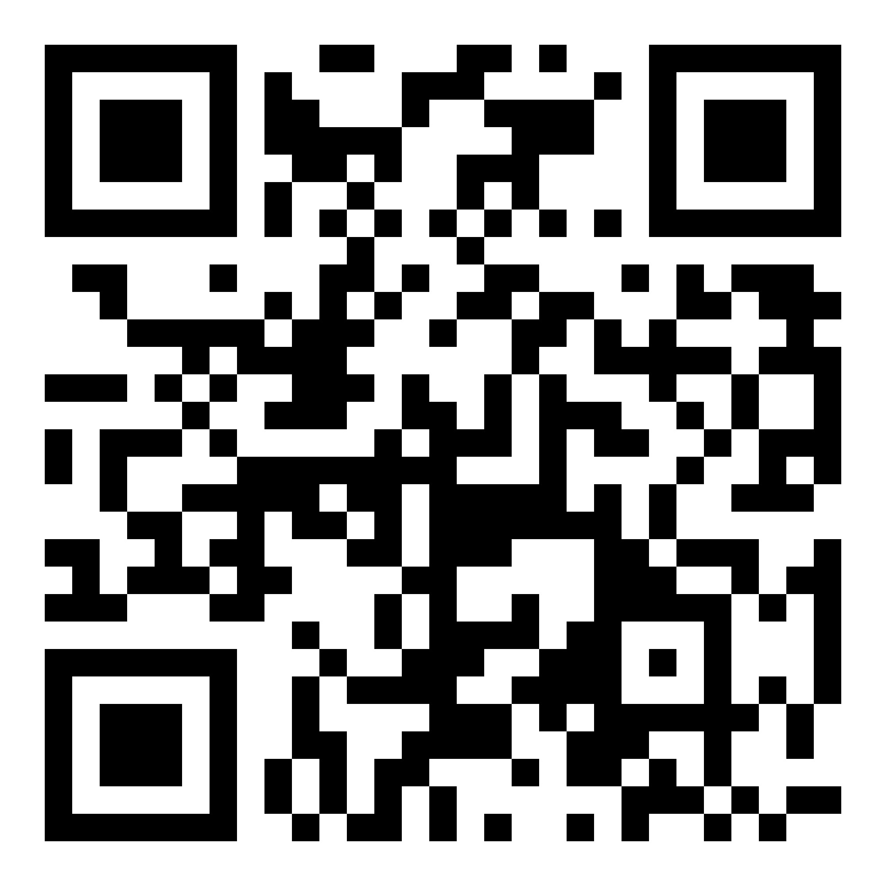
2024-2025
District Goals
Student Success
Staff Development and Support
Strategic Planning
Community Engagement
Operational Excellence

Slide 5

Vision: Ensure student success by enhancing systems and structures for
sustained accountability.
Mission: To promote learning by empowering R.O.A.R.
R
esilience (don’t quit; resilience is our superpower)
We provide a safe space to bounce back and learn from mistakes.
We provide academic, social, and mental well-being support.
pportunities: (don’t settle, be curious and ask questions)
We provide enriched learning experiences in and out of the classroom.
We provide equitable resources to support technology trends in an ever-changing world.
chievement: (inspire hope and unlock peak performance)
We provide various interventions and enrichment to meet diverse learning needs.
We provide continuous celebrations to support accomplishments.
elationships: (be kind and make connections)
We provide resources and guidance to foster the home-school connection.
We provide robust outreach to encourage unity and transparency within the community.
O
A
R

Slide 6
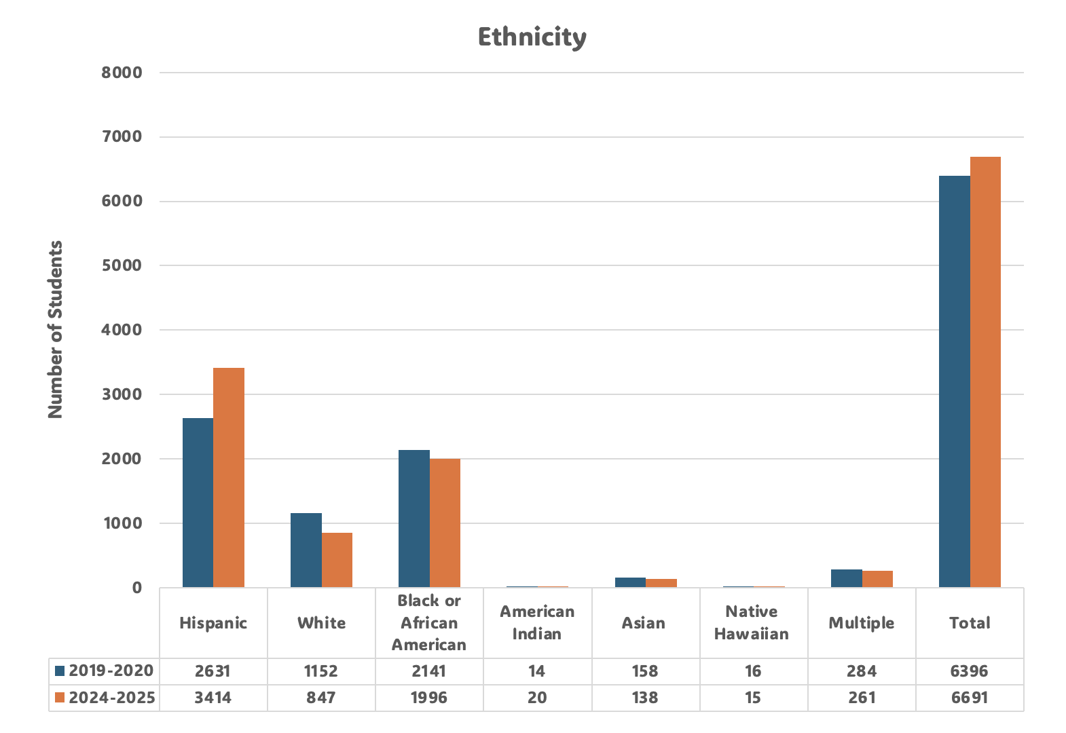
Demographics

Slide 7
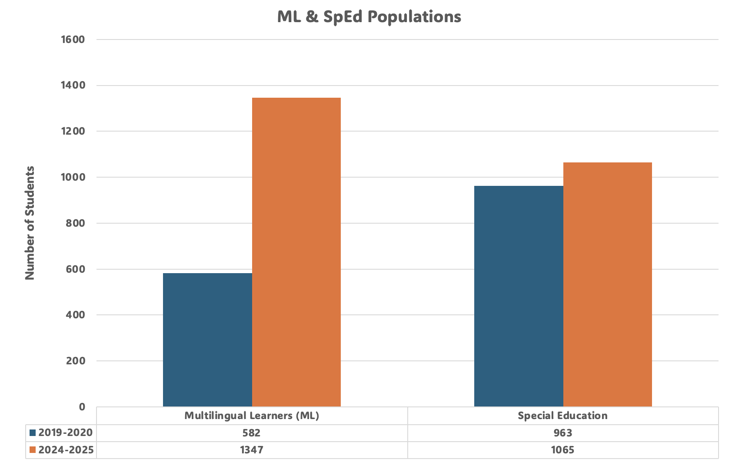
Special Program Enrollment

Slide 8
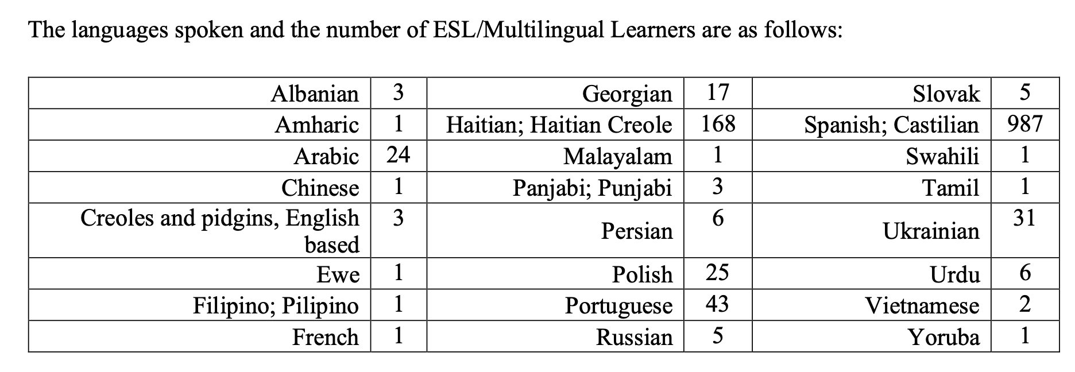
33 Languages Spoken Linguistic Diversity

Slide 9
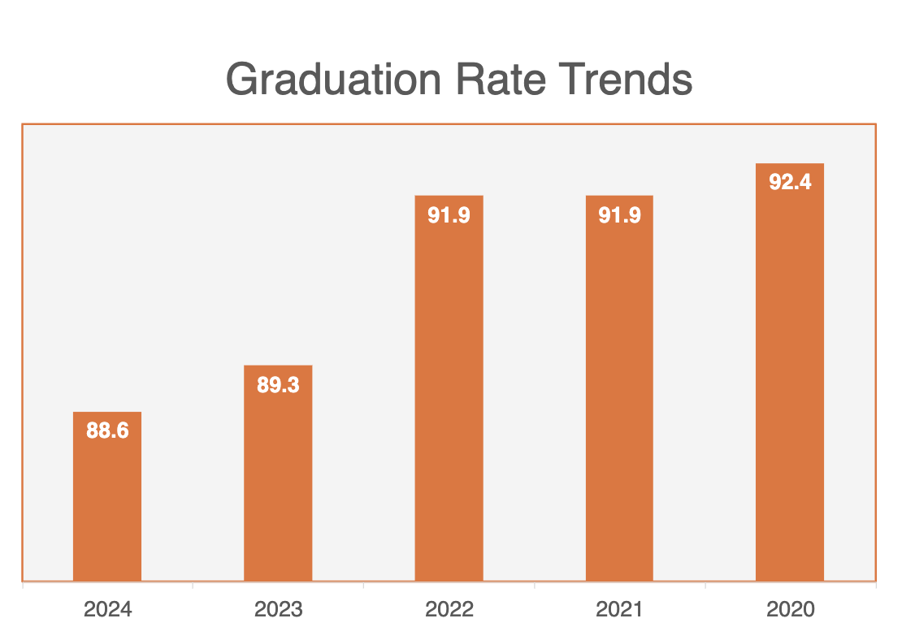
Graduation Trends

Slide 10
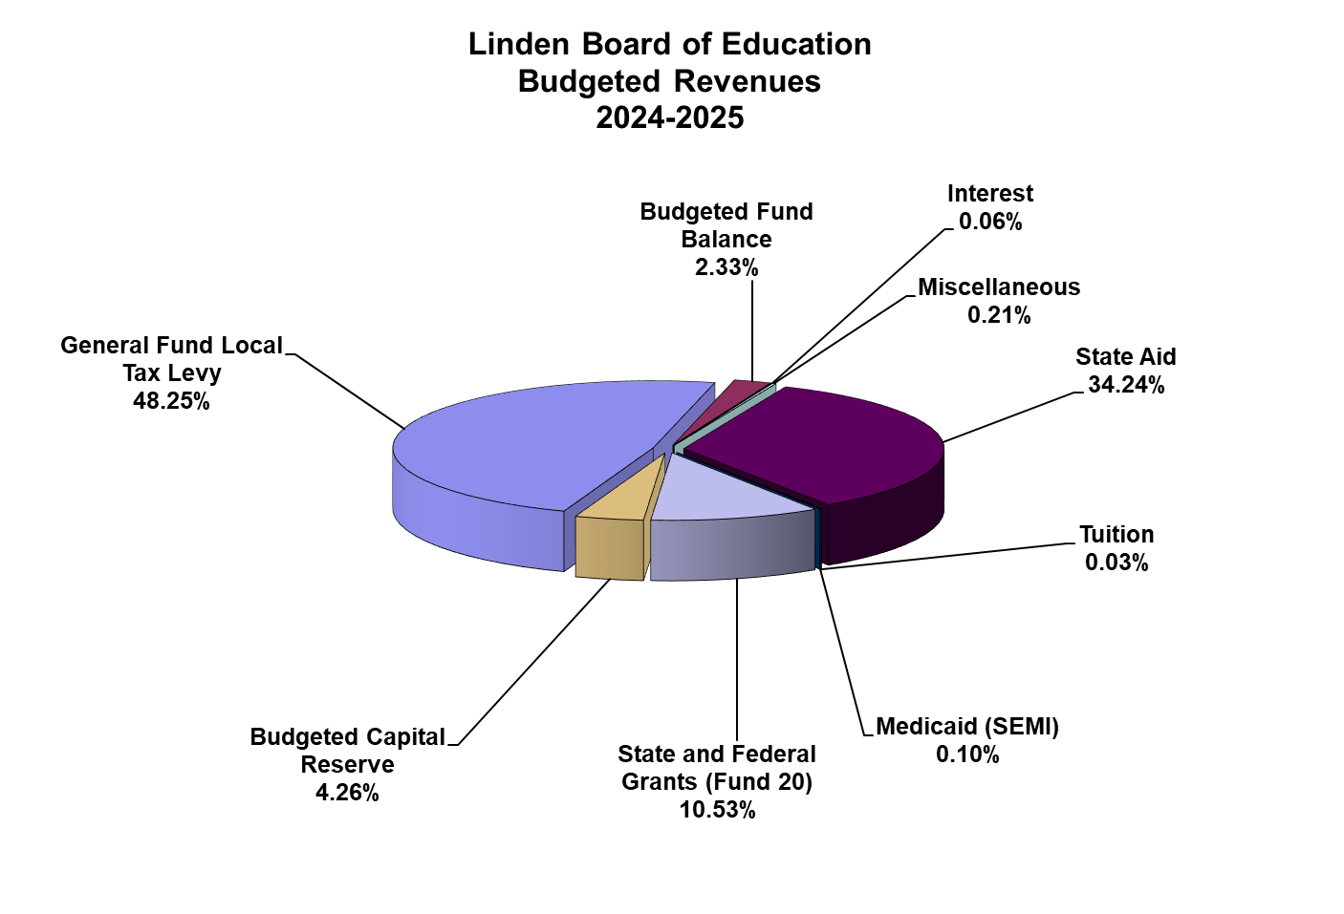
Finance: Budget Revenues:
0% Tax Increase
$191,107,759 Operating budget
Healthy reserves

Slide 11
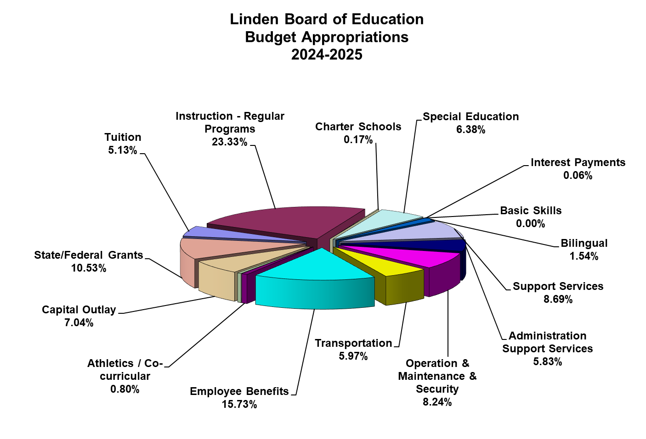
Finance: Budget Appropriations:

Slide 12
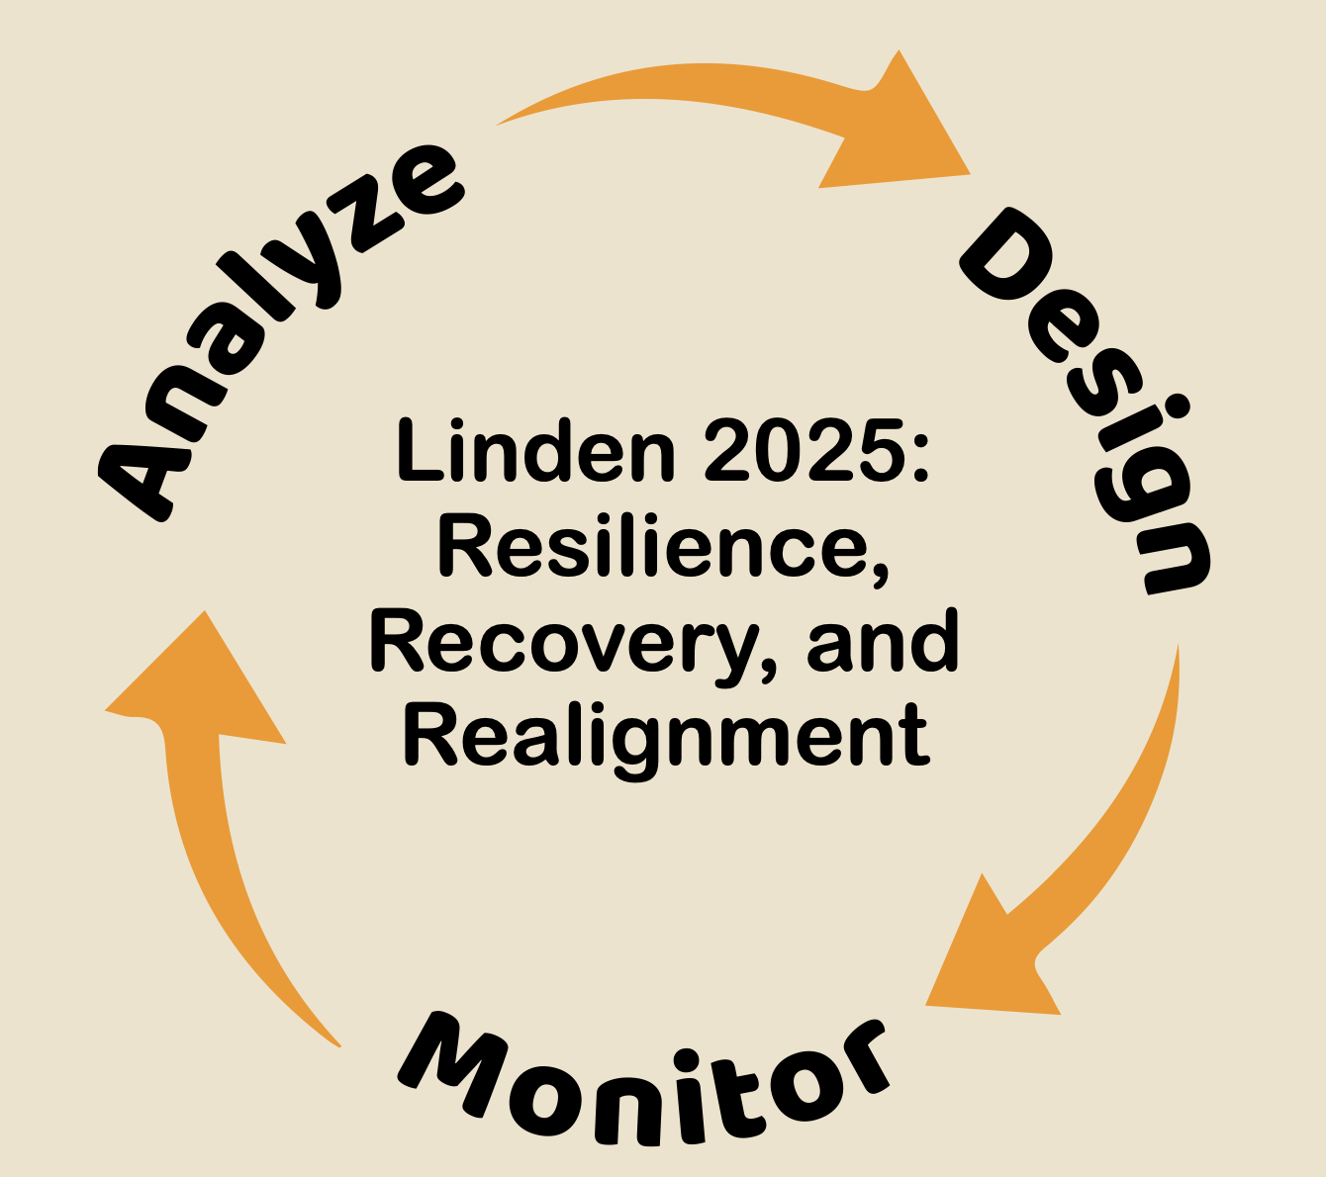
Strategic Plan 2020-2025 Accomplishments
Facilities
Upgrades: bathrooms, ceiling tiles, lights, roofing, flooring, HVAC
Fencing installations
Renovated: TV studio, Weight room, Gymnasium floors, Science rooms
Creation of Welcome Center
Increase in Early Childhood classrooms (5 per year)

Slide 13
Strategic Plan 2020-2025 Accomplishments
Academics
Cyclical review for all curriculum
Data-informed teaching
International Baccalaureate Program (IB)
Advanced Placement courses (AP)
Expansion of Navy JROTC
Expansion of PreK 3 and PreK4 programming
Expansion of Special Education programming
SLIFE (students with limited or interrupted formal education) programming at LHS
Seal of Biliteracy
Alternative School
Adult ESL Classes
CTE Curriculum development and pathway alignment
CTE Certifications for Students
Best Communities in Music Education (10 consecutive years)

Slide 14
Strategic Plan 2020-2025 Accomplishments
Academics
Increase in dual enrollment programs:
  Union County College
  Kean Scholars Academy
  Berkley College
Gifted and Talented (elementary)
Tutoring: High Impact Tutoring Grant, Title I, ESL
Tuition-free summer school
  Remediation (Elementary)
  Bridge Program (5th – 6th / 8th - 9th)
  Credit recovery (Middle and High School)
  Extended school year
  Enrichment programs
    Science, Technology, Engineering, Arts, Mathematics (STEAM)
    English as a second language

Slide 15
Strategic Plan 2020-2025 Accomplishments
Support
Mental Health Services Support for Students
Comprehensive wrap-around services
  Parent Universities
  External support services for mental health, food, security, health insurance
  Services for displaced families
Anonymous wellness and safety app
Partnership with Rutgers University clinicians
Educator Stakeholder Climate and Culture Survey
Student peer-to-peer learning experiences

Slide 16
Strategic Plan 2020-2025 Accomplishments
Support
Laser focus on College and Career Readiness
  Portrait of a Graduate 3E pathways exposure: Education, Employment, Enlistment
  Increase in student scholarships
  Increase in students enrolled in 4-year degree program
  Increase in student enrolment in trade/technical schools
  Establishment of a College and Career Readiness Counselor
Restorative practices
Utilization of the Project Lead the Way engineering program
Implementation of Social Emotional Learning (SEL) using an integrated model
Multi-tiered Systems of Support (MTSS): RTI (Response to Intervention), Positive Behavior Support in Schools (PBSIS), Remedial Reading, and Title 1
21st Century After-school program at SMS
Before and After-care (elementary schools)

Slide 17
Strategic Plan 2020-2025 Accomplishments
Recruitment and Hiring
1,164 Employees
Hosted and attended job fairs to actively recruit new staff
Conduct exit interviews to support retention strategies
Expanded state and national networks with 3rd party online recruitment organizations
Developed a substitute training program
Partnered with higher education to offer staff tuition discounts
Partnered with a substitute staffing company
Streamlined onboarding process
Enhanced transparency to build capacity

Slide 18
Internship Partners

Slide 19
Strategic Plan 2020-2025 Accomplishments
Professional Development
Building-based instructional leadership teams (ILT)
Sheltered Instruction Observation Protocol (SIOP)
Instructional Coaches
Professional Development Series
Train-the-trainer module
Administrator internal walks
Vertical articulation
Team-time
Common planning
Professional learning communities
Peer-to-peer observations
On-site PD through partnerships with Higher Education and State/National organizations
Executive Coaching
Apple Professional Learning Series

Slide 20
Strategic Plan 2020-2025 Accomplishments
Community/Parent Engagement
It Takes Village
Public Service Announcement student video contest
Increase use of Social Media presence
Enhanced Video Media productions
Enhanced communication through multiple languages
L.E.A.D (Law Enforcement Against Drugs)
NJ Family Care
NJ 4S
Department of Health
Assistive devices for translation support
Multi-generational community engagement events
Student participation in city-wide events
Newsletters
PTA/PTOs

Slide 21
Strategic Plan 2020-2025 Accomplishments
Technology
Apple One-to-One program iPad or MacBook
10 Apple Distinguished Schools
Apple Distinguished Educators
Host for technology professional learning
Robotics and STEM applications
Promethean boards in all classrooms
Use of adaptive digital platforms to assist students on individual learning paths

Slide 22
Strategic Plan 2020-2025 Accomplishments
Security
Lens one touch lockdown
Installation of phones in all classrooms
Installation of internal and external cameras
Visitor management system
Weapons detection system at secondary levels
Increase in security personnel
Installation of vape detection system at Linden High School
Yonder pouches at secondary levels
Installation of AI weapons detection system at Linden High School
Cybersecurity

Slide 23






FORWARD FOCUS
Student Achievement
Technology
Big ideas come from forward thinking people who challenge the norm, think outside the box, and invent the world they see inside rather than submitting to the limitations of current dilemmas
T.D. Jakes
Mental Health
Student Safety
Fiscal Resources

Slide 24
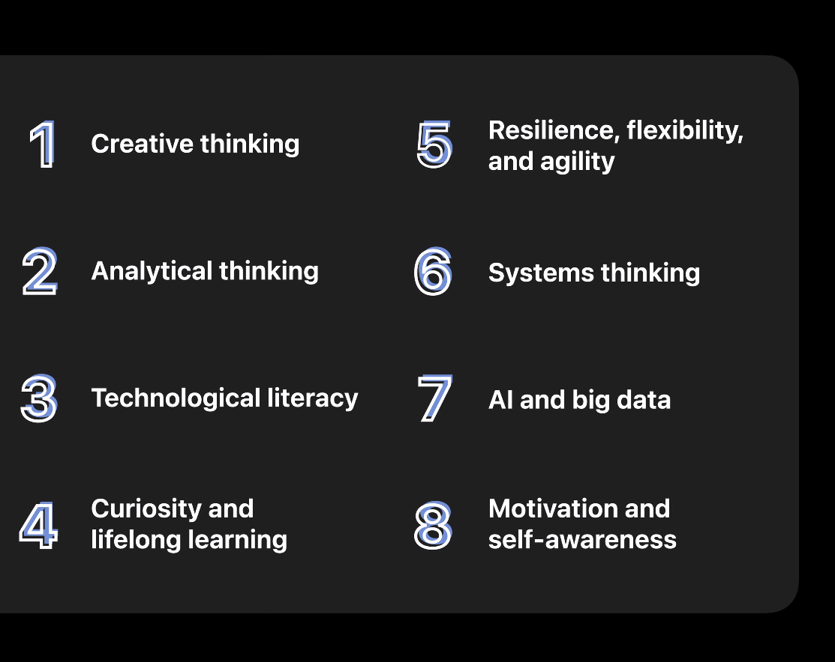
Skills on the Rise:
Future of Jobs Survey, 2023, World Economic Forum

Slide 25



We need YOU to help us prepare today’s students for tomorrow’s world!

