Slide 1
Linden Public Schools
2021 Delta Dental Plan
July 1, 2021

Slide 2
Getting the most from your Delta Dental Benefits
Your Dental Plan
Benefit Enhancements:
CarryOver Max
Oral Health Enhancement
Networks Available
Member Experience
Delta Dental Contact Information
Oral Health Information
Additional Plan Information

Slide 3
Your Dental Plan

Slide 4
Linden Public Schools | Delta Dental PPO Plus Premier TM
Calendar Year Deductible (Waived for Preventive & Diagnostic) Per Person Family Aggregate Deductible | $25 $75
Calendar Year Maximum – Per Person | $1,500
Preventive & Diagnostic (Frequency limitations apply) Exams, Cleanings, Bitewing X-Rays Fluoride Treatment (once in a calendar year, children to age 19) Sealants (children to age 14) | 100% Covered
Remaining Basic Fillings, Extractions Root Canals (Endodontics) Periodontics, Oral Surgery Repair of Dentures, Crowns & Gold Restorations | 80% Covered
Major Bridgework, Full & Partial Dentures | 60% Covered
Orthodontic Benefits (Adult, and Child to age 19) Coinsurance Lifetime Maximum – per-patient | 50% $1,000
Dependent Children of enrolled employees are covered to the end of the year they age 26.
This overview contains a general description of your dental care program for your use as a convenient reference. Complete details of your program appear in the group contract between your plan sponsor and Delta Dental of New Jersey, Inc.

Slide 5
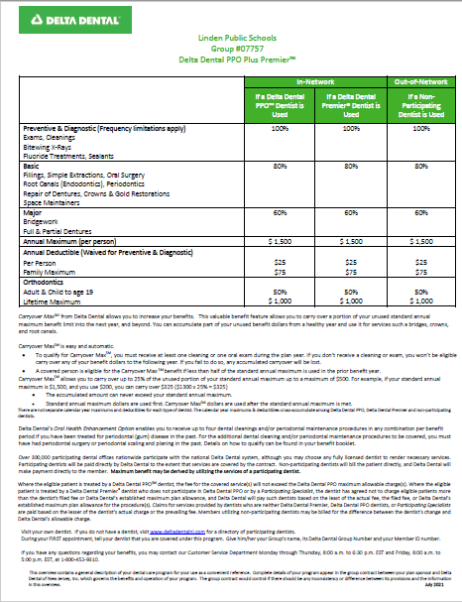
Plan Summaries Please click on the link below and scroll through for your dental plan information
PPO Plus Premier Plan
Coinsurance percentages indicate what Delta Dental pays towards your visit to the dentist.
Plan Maximum indicates the total amount Delta Dental will pay per benefit period
Deductibles apply, per plan benefit period, as indicated
Using a non-participating (out-of-network) dentist may result in balance billing
This overview contains a general description of your dental care program for your use as a convenient reference. Complete details of your program appear in the group contract between your plan sponsor and Delta Dental of NJ, Inc.

Slide 6
Benefit Enhancements within your PPO Plus Premier Plan
Carryover Maximum
Benefit feature for members to carry over up to 25% of their unused standard annual maximum in one year to increase benefits for the following year
To qualify Delta Dental requires an annual preventive visit or cleaning
If you do not submit a claim for an exam or cleaning, any accumulated Carryover Max benefit will be lost.
Oral Health Enhancement
Helps members who have been previously treated for periodontal (gum) disease manage their oral and overall health
Qualifying members must have history of periodontal disease
This benefit offers you up to four dental cleanings and/or periodontal maintenance procedures per benefit period

Slide 7
Networks Available
PPO
Plus
Premier

Slide 8
Delta Dental PPO Plus Premier™ Nationwide Networks
If you use a Delta Dental PPO™ dentist
Your out-of-pocket costs will be lowest for services if you use a participating PPO dentist.
Your Annual maximum stretches further because the dentists' fees are lower
Participating dentists may not charge more than Delta Dental’s allowed charges, and are paid directly by Delta Dental for covered services
If you use a Delta Dental Premier® Dentist
Our largest nationwide network.
Your out-of-pocket costs will be higher, and your plan maximum will not go as far, since Premier dentists' fees are higher than PPO dentists
Participating dentists may not charge more than Delta Dental’s allowed charges, and are paid directly by Delta Dental for covered services
You may use dentists that do not participate with Delta Dental
You are responsible for submitting the claim
You are responsible for making payment to the dentist
Your out-of-pocket costs are highest when you use non-participating dentists

Slide 9
Your Delta Dental PPO Plus Premier™ Plan At a Glance
* For illustrative purposes only. Fees vary by procedure and location.
* Please note that an out-of-network provider is not bound by Delta Dental’s in-network contractual obligations and may bill patients for the remaining balance, called balance billing. The practice of balance billing refers to a provider’s ability to bill patients for outstanding balances after the insurance company pays the required portion of the bill (coinsurance percentage).
** Check your specific plan to see what the coinsurance rate is as they differ from plan to plan.

Slide 10
Member Experience

Slide 11
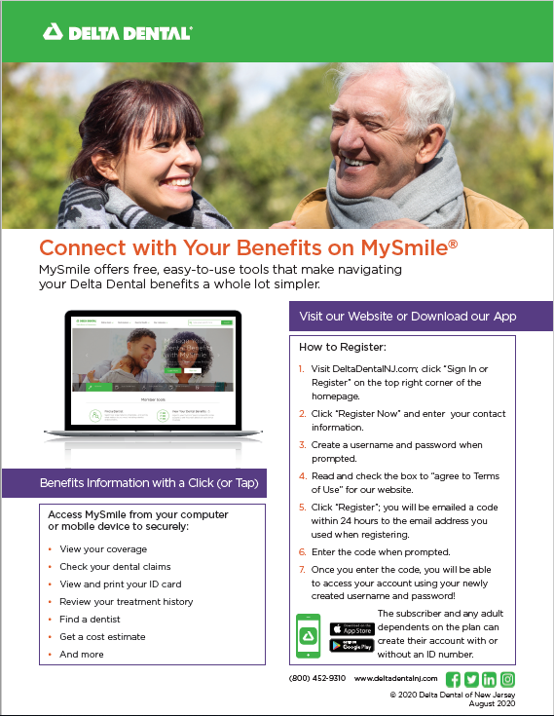
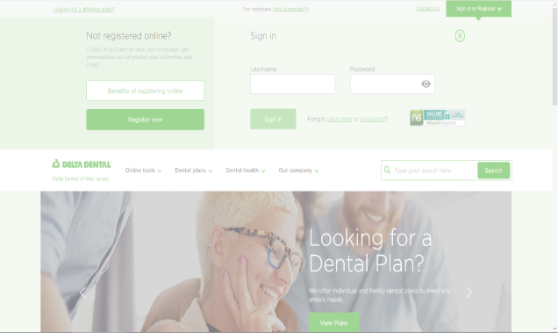
Delta Dental of NJ Website
Register and log into your My Smile® account at DeltaDentalNJ.com to access your dental benefits information
Use the same log in information to access your dental benefits information in the Delta Dental App
Need a dentist? Click our ‘Find a Dentist’ to search for a dentist near you
Step- by- Step
Website Registration

Slide 12
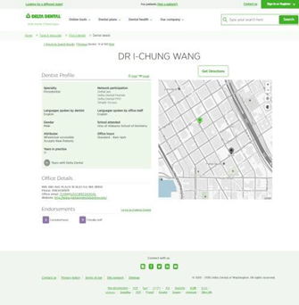
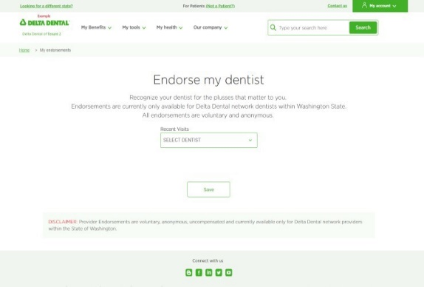
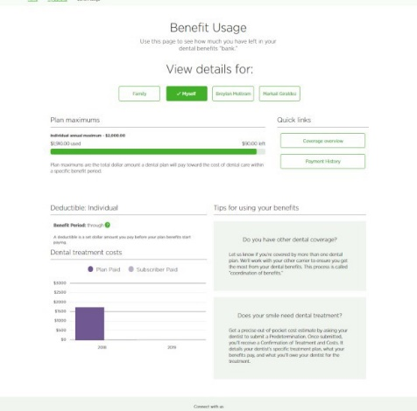
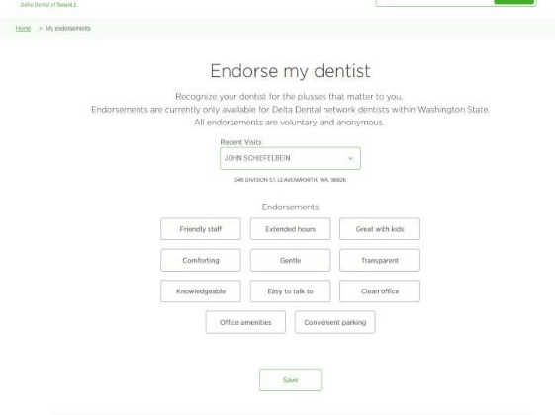
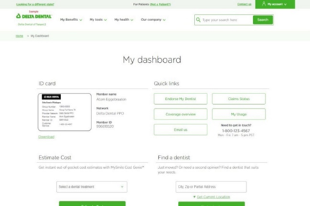
New Tools Make It Easier To Navigate Our Website
Mobile Friendly
Member Dashboard
with ID card
Dentist Finder
Dentist Endorsements
Cost Estimator

Slide 13
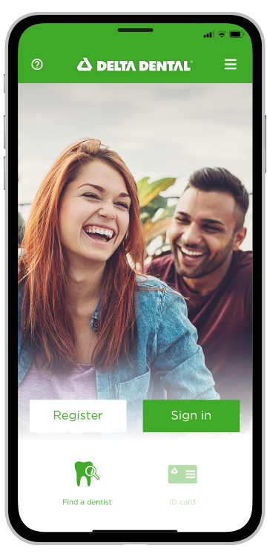
Your mobile tools – Delta Dental mobile app
Register or Log in
ID card
Find a Dentist in your Plan Network
Save Your Preferred Dentist
Review Claims and Coverage
Cost Estimator
MyDentalScore Risk Assessment

Slide 14
Delta Dental Contact Information

Slide 15
Your Resources – Connect with Delta Dental
Linden Public Schools
Delta Dental Group # - 07757
Customer Service 800-452-9310
Call, go online, or download our mobile app for these services:
Verify eligibility
Review benefits
Look up claim payments
Find a dentist
Cost Estimator – on mobile app
Print an ID card – or have it on your phone
Website: www.deltadentalnj.com

Slide 16
Oral Health Information

Slide 17
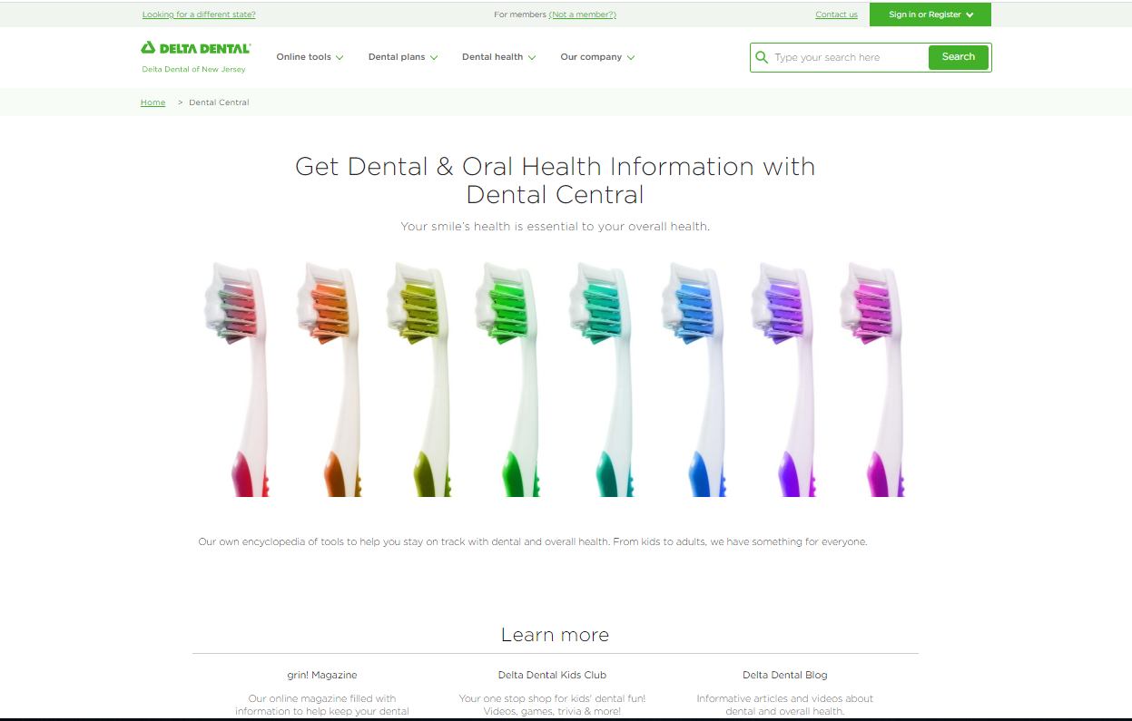
Oral health and wellness information
Your one-stop dental resource hub
Library of articles on oral health & wellness
Videos on dental topics
Oral health risk assessment tool – MyDentalScore.com
Grin! Magazine – quarterly online wellness magazine
Resources on:
Smoking Cessation
Hygiene Practices
Vegan Diet

Slide 18
Additional Plan Information

Slide 19
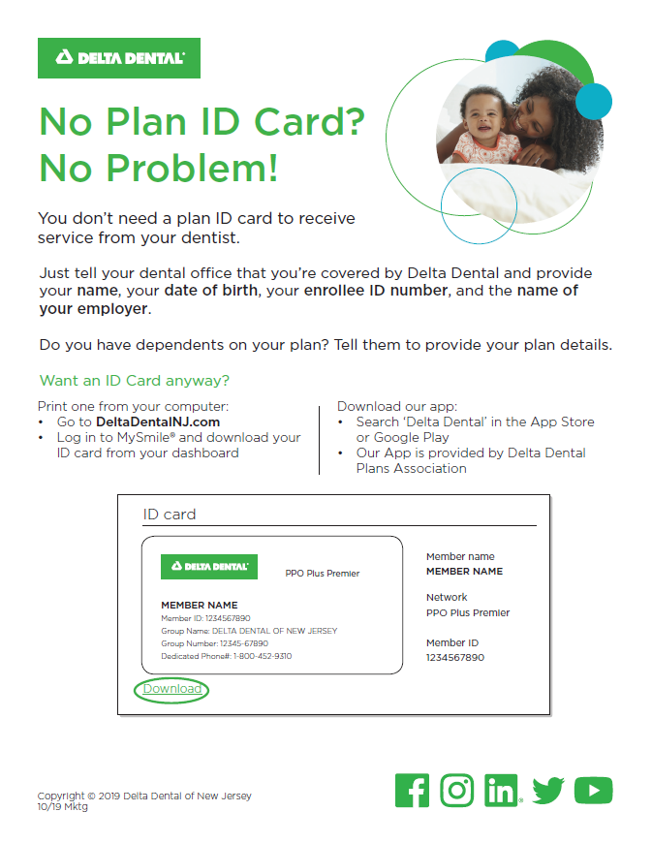
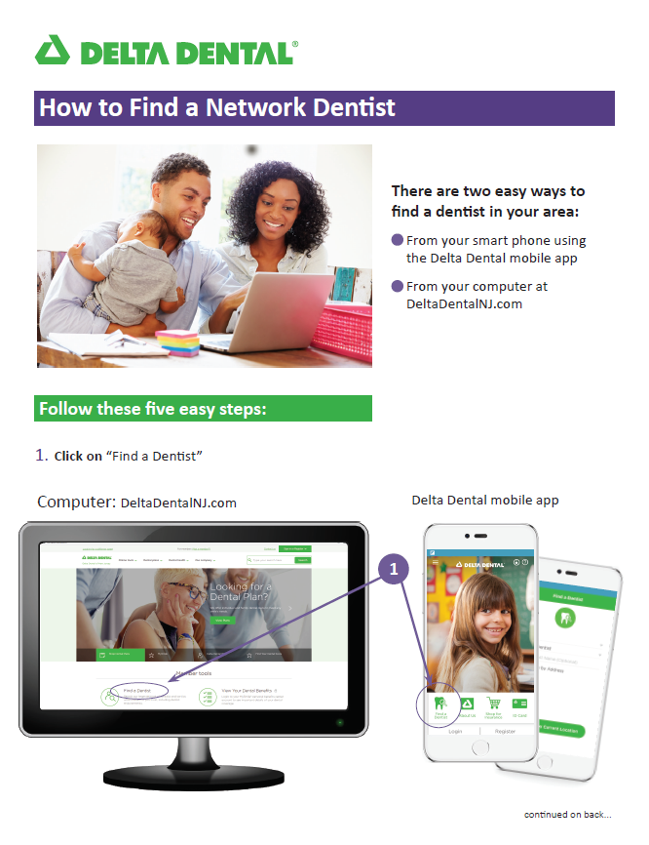
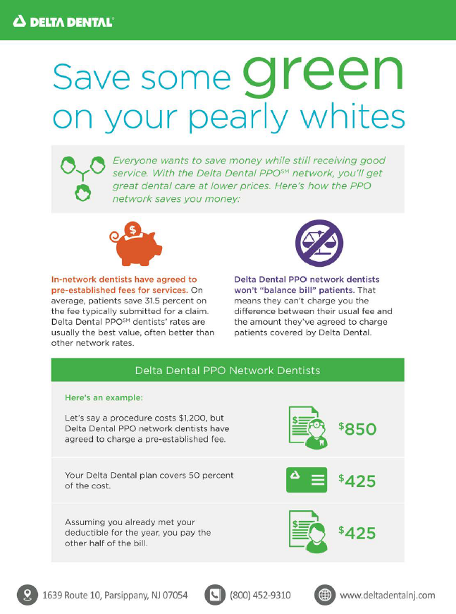
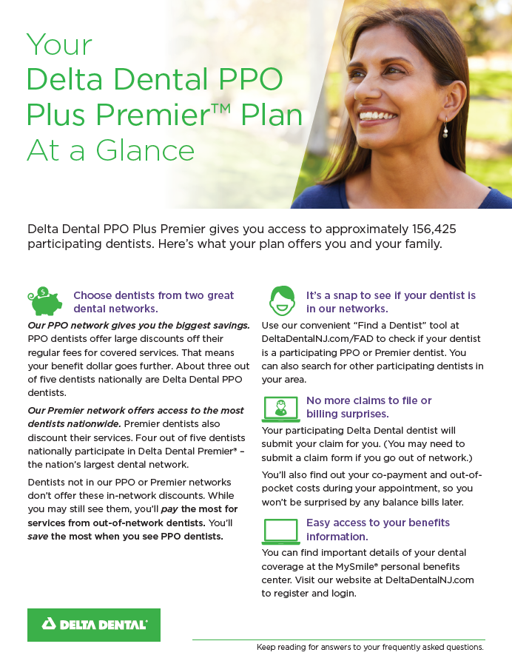
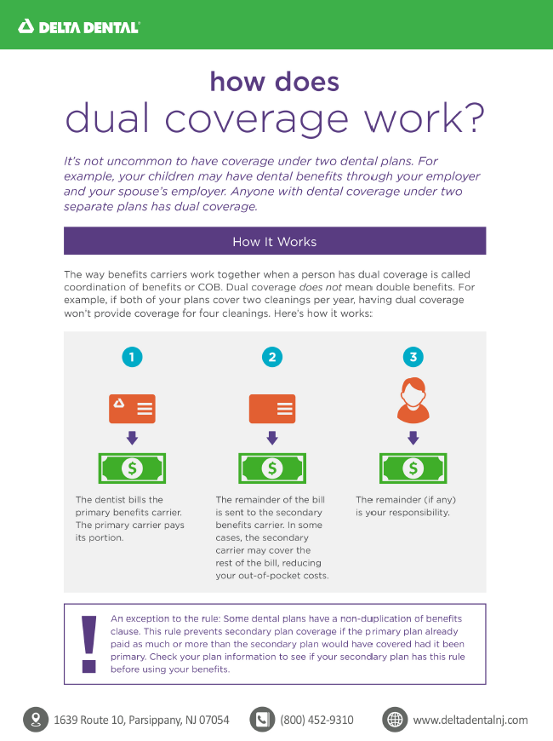
Website Registration
ID Card
Find a Dentist
Save Some Green
PPO Plus Premier
At A Glance
Dual Coverage

Slide 20
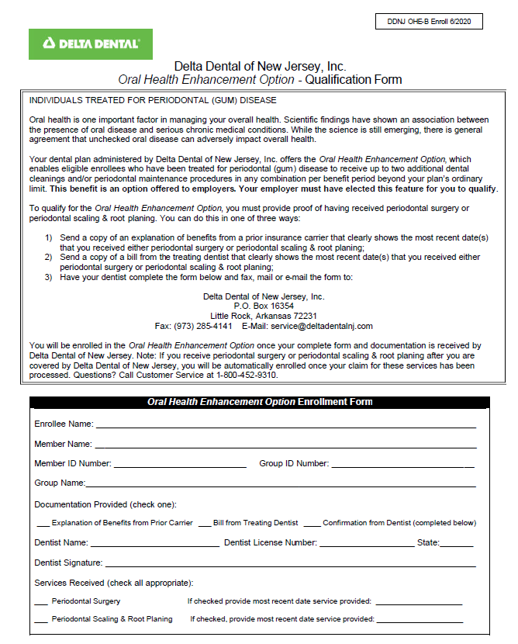
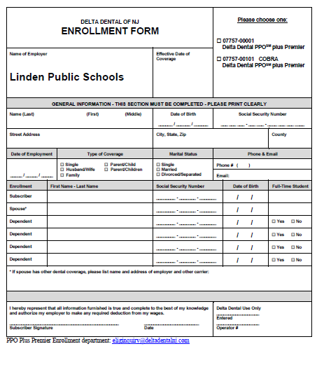
Forms
Oral Health Enhancement Form
Enrollment Form

Slide 21
QUESTIONS?
Log into the MySmile® Portal OR Contact Us at 800-452-9310

