Slide 1
Administrators’ Meeting
August 29, 2023
John Serapiglia

Slide 2
Duties and Responsibilities
Custodial Staff– Principals/Directors
Custodial/Maintenance & Facility Issues
  Jason Anderson / Rolando Ramirez
All things pertaining to Budget/Copiers
  John Serapiglia / Pamela Caporale
Repairs of Clocks/Intercoms/Purchasing Questions
  Tracey Williams

Slide 3
DUTIES (CON’T)
Transportation Questions
    Lisa Ormon
Payroll
    Jennifer Rodriguez
Benefits
    Taryn Ragonese-Carlson
  Lunch Program/Application Information/My School Bucks
    Elizabeth Nowak
  Grants
    Pamela Caporale
  Questions regarding Purchase Orders
    Vendors A-L / School Specialty: Michelle Dynda
    Vendors M-Z Yvonne Mendez
    Requisitions / new vendors: Val Thompson

Slide 4
DUTIES (CON’T)
Use of Facilities for Agenda:
  Winnie Lormejuste – (Educational Use)
  Tracey Williams - (Non Educational Use)
  Please adhere to agenda item deadlines.
  Retroactive approval does not assure insurance coverage for the event.

Slide 5
Items Needing Board Approval:
Check the calendar for the date of board meeting.
Items needing certification should be placed on agenda prior to submittal.
Plan to submit items to the Business Office by Monday of the week before board meeting.
E-mail agenda items to Topaze Maccioli that go on the Finance. Use of Facilities e-mails go to Tracey Williams. Copy me on both.
SEND IN ITEMS AS SOON AS POSSIBLE

Slide 6
Items Needing Board Approval (Professional Development)
VERY IMPORTANT: ALL PROFESSIONAL DEVELOPMENT / CONFERENCES NEED BOARD APPROVAL PRIOR TO ATTENDANCE.
Failure to get prior Board approval means conference CANNOT BE PAID FOR by Board of Education
New forms this year
  Breaks down all costs
    Lodging / Registration / Mileage / Parking / etc.
  Rules in place for how much meal reimbursement is
For reimbursement submit backup.

Slide 7
Change in Use / Splitting Rooms / KG and Pre-k rooms with toilets
Contact John Serapiglia to discuss

Slide 8
Construction
Lots of Construction went on over summer
Some of it is still ongoing
  Bathrooms at School #1, #4, Academy
Some of it is still needed to be done (blame the supply chain):
  Wall padding
  Marquees
  Rubber Mulch
  Playgrounds
  Gym floors
  New phones / security upgrades
Some of it is yet to come
  Roofs
  Additional Ceiling tiles / lights
  Additional Bathroom work

Slide 9
Construction
One of goals of my office is to make your schools look and work better
Please let me know your thoughts (especially at budget time)
Items on my radar
  Upgrade Science Rooms
  Continue ceiling tile / light replacement
  HVAC work
  Floor work
  Roof repairs
  Playgrounds for rest of elementaries

Slide 10
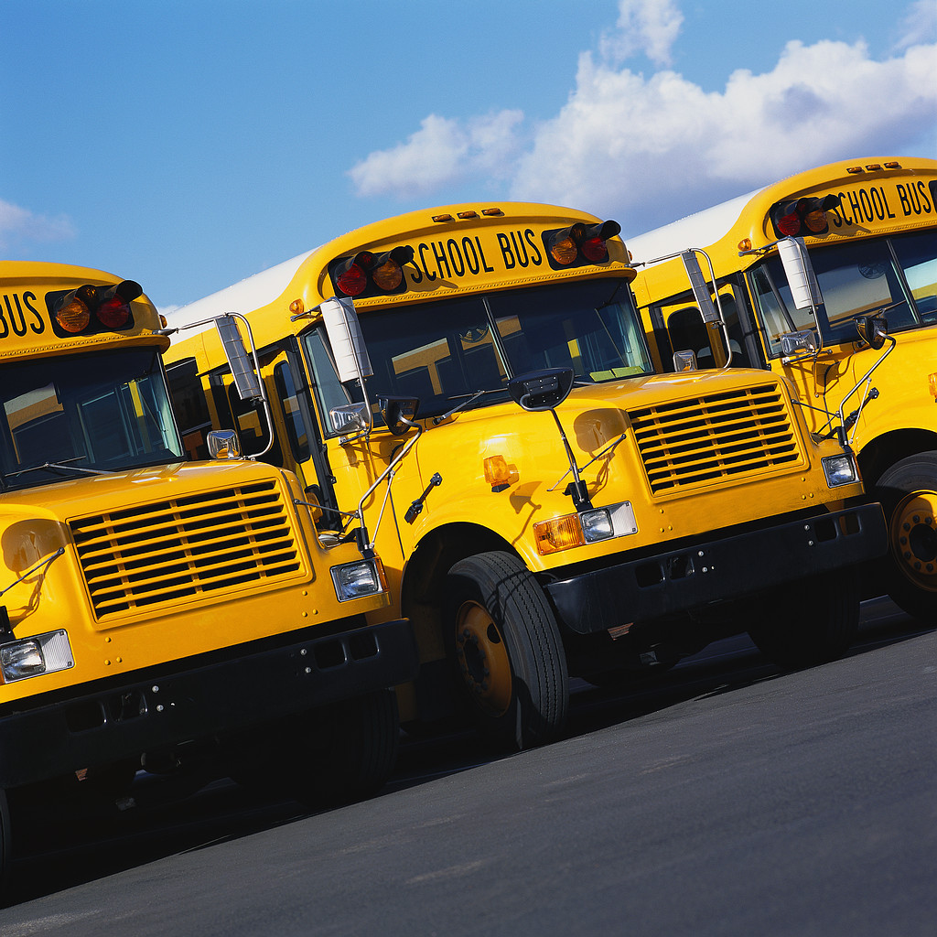
Transportation
Issues

Slide 11
Transportation Department
Transportation data base available for use at all schools in Trans Info.
Secretaries are able to get bus lists off the computer.
If the bus is late or early on the first day of school understand it is the first day. If it is chronically late notify Lisa Ormon in the Transportation Office.
If no bus arrives on any day call transportation.

Slide 12
TRANSPORTATION (CON’T)
All bus letters were mailed to parents.
Field trip requests, Special Education transportation requests, change of student transportation requests – need to be sent to the Transportation Department within the proper time frame.

Slide 13
Transportation Forms
Request for/or Change of - Student Transportation
Request for Coordinated Special Education Transportation
(All forms are available through e-mail.)

Slide 14
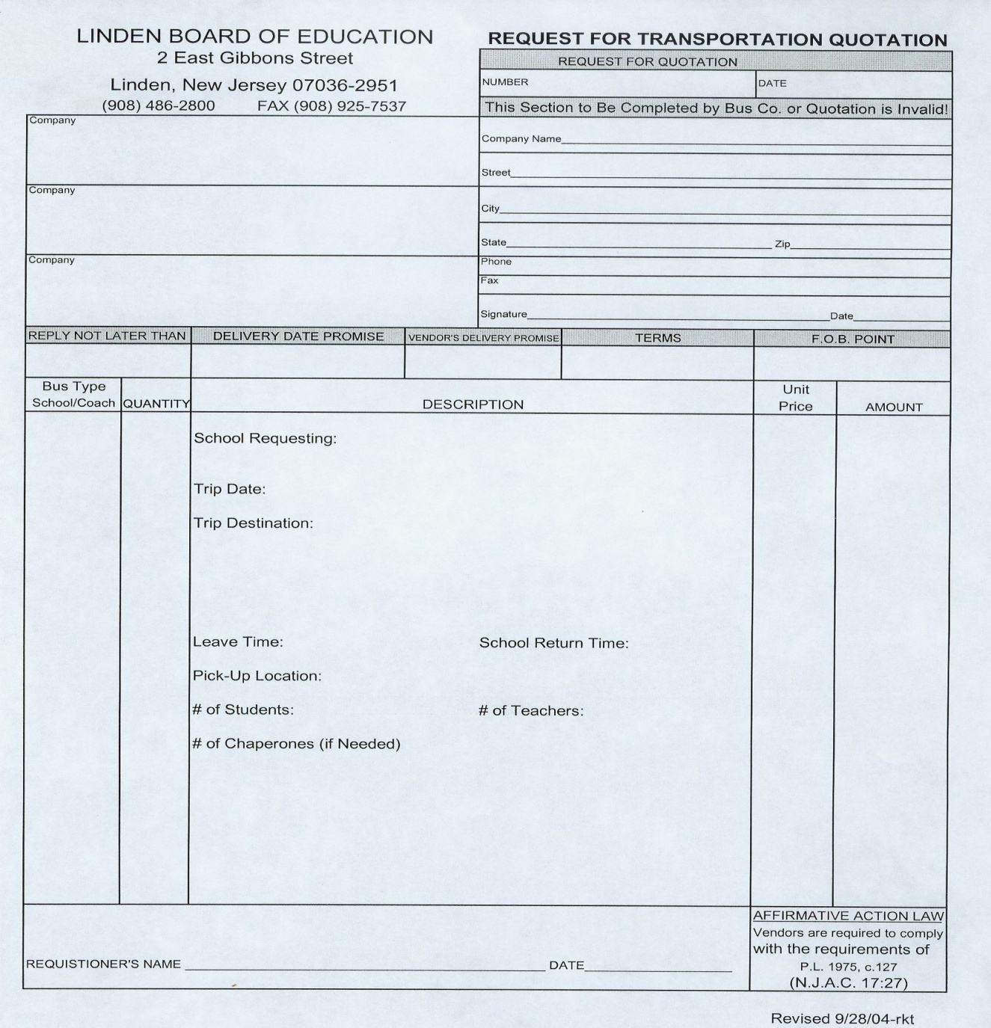

Slide 15
Maintenance
Please put in requests through maintenance work order system
Jay / Roly are excellent at getting this work done
Any work you want to do pertaining to rooms please let these guys know

Slide 16
Timesheets

Slide 17
TIMESHEETS
Must use appropriate form or it will be returned to employee.
Employee must actually do what is on timesheet request. Administrator in charge must verify when signing off. Account numbers must be placed on all timesheets.
Agenda item must be attached to all timesheets
Timesheets are handed in monthly. Some semi-monthly (custodial overtime, PT aides, substitute secretaries, student workers).

Slide 18

CAFETERIA
This Photo by Unknown Author is licensed under CC BY-NC-ND

Slide 19
CAFETERIA
23-24 Meal Applications
  Please encourage parents (i.e. Back to School Night) to fill out the applications as it helps to determine what State Aid we are entitled to (Have a laptop set up and someone to assist in filling out applications at Back to School Night)
  Applications may be filled out online. However, schools must provide paper copies at the request of parents/students to be forwarded to Liz Nowak at the Business Office for processing
  Carryover eligibility for 2022-23 applications expires in October. Reminders will be sent to parents around October 1st so that they still have ample time to submit new application

Slide 20
CAFETERIA
Student Meal Procedures
  All students must physically have their Student ID’s in the service line as we have employed the use of scanners to speed up the process
  Limited snacks and a la carte items will be made available beginning on the first day of school (with the option to expand later in the school year)
    Elementary Schools – Complete meals will be served to all students first. If there is time left in the lunch period, students may come back up for snacks
    Middle & High School – Students may purchase snacks at any time during the meal period
  Please encourage prepayment of meals (No more negative balance limits).
    Preferably through My School Bucks
    Cash/Check pre-payments will be accepted at breakfast and in the hours before lunch periods begin

Slide 21
CAFETERIA
Staff Meals
  To start out the year, only lunches will be made available to teachers (limited menu)
  We encourage the use of My School Bucks for payment, but will accept cash at the register
  If a staff member encounters trouble locating their adult account in My School Bucks, please contact Liz Nowak to have one created
Water
  Water fountains should be turned on.

Slide 22
CAFETERIA
Nutrition Advisory Committee
  Each School Principal must select parents, teachers, and students from each grade level to serve on the committee
  Principals must coordinate the date and time with Pomptonian
  Board members will be invited to attend as well
  Pomptonian will meet at least once during the school year with each school

Slide 23
BUDGET

Slide 24
Budget
Please analyze spending patterns when making the new budget.
Do not just duplicate your current budget year after year.
Budget sheets with spending histories will be sent out to Principals / Supervisors / Directors
Individual budget meetings can be arranged with each administrator.
Budgets are due around December 2023.
E-mail budget in Excel worksheet format only to the Business Administrator.
Please make sure to include potential new hires along with justifications (Class sizes / changing dynamics)

Slide 25
BUDGET (CON’T)
Any budget questions are to be directed to the Business Administrator.
If things are not budgeted in fund 12 at budget time, they cannot be ordered for this year. Any single item over $2,000.00 is equipment and a Fund 12 account must be established at budget time.
Budgets may be reduced depending on district expenses.

Slide 26
PURCHASING
We are subject to purchasing laws (simply cannot buy items as much as we want to)
For the most part we are going to push you guys into cooperative (outside organizations that have done the work of bidding for us)
If not enough money in account – contact my office to discuss a transfer
Our offices will be checking Purchase Orders to ensure correct account codes used / correct purchasing procedures done
Please let my offices know of any events occurring in your buildings where money is exchanged – purchasing laws unfortunately still apply
  Example: Yearbooks

Slide 27
Budget Accounts
300/320
  Purchased Professional Educational Services-
  Services supporting the instructional program.
  Direct Student contact. Not including BOE employees. Education Consultants, Assemblies, and Professional Development Speaker that in brought in to the district.
  11-XXX-XXX-320-00-000-XX-XXX

Slide 28
Budget Account (Con’t)
500/590
Other purchased services-
Amounts paid for services rendered to people that do not work for Linden
  Blue Card travel expenses (580)
  Travel expenses for Professional Development (580 PD)
  11-XXX-XXX-580-00-000-XX-XXX
  11-XXX-XXX-580-PD-000-XX-XXX

Slide 29
Budget Account (Con’t)
600/610
Supplies-
Any single item with a cost of under $2,000
Consumable instruction materials (workbooks, etc.)
Office supplies
  11-XXX-XXX-610-00-000-XX-XXX

Slide 30
VARIOUS ITEMS
We have changed health insurance – any questions please contact benefits coordinator
We are going to be changing over ALL copiers throughout district.
Buying stuff for teachers – Accountability Regulations
Please make sure to talk to us about changes in your building. We want to make sure they happen correctly.

Slide 31

Questions
Please call, email, or text with any questions during the year.

